Slide 1













TIME SERIES FORECASTING: Week 1

Slide 2




DSBA CURRICULUM DESIGN
CORE COURSES
DOMAIN APPLICATIONS
FOUNDATIONS
Data Science Using Python
Advanced Statistics
Finance and Risk Analytics
Statistical Methods for Decision Making
Data Mining
Predictive Modelling
Marketing and Retail Analytics
Machine Learning Data Visualization
SQL
Time Series Forecasting (Week-1/4)

Slide 3


LEARNING OBJECTIVE OF THIS COURSE
Time Series Analysis
Time Series Forecasting –
Introduction to Forecasting
ARIMA Models

Slide 4

LEARNING OBJECTIVES OF THIS SESSION
Time Series Analysis – A descriptive view of Time Series
Exploratory Data Analysis for Time Series data

Slide 5











TRY ANSWERING THE FOLLOWING
If the Time Series data has missing values, we are allowed to drop those data points from our analysis. – True or False? Discuss.
The residuals in a decomposition of a Time Series gives us the idiosyncratic part of the series which is not picked up by the Trend and Seasonality. – True or False?

Slide 6

BROAD OVERVIEW
Time Series Analysis is about exploring the Time Series data from a descriptive perspective. In this session, we are not going to forecast or predict. We will look at the Time Series data from various perspectives to understand the behaviour of the data over time.
We are going to use the statistical descriptive tools and techniques that has been learnt previously but we will see how to use those techniques to describe the data over time.
In this session we will look at the question, “What does the data tell us?”

Slide 7

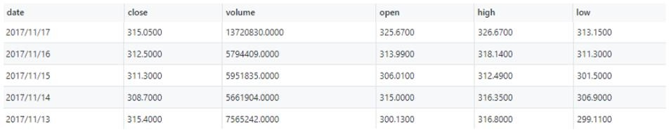
Industry Application – Predicting Stock Prices
Time Series Forecasting procedures are used to predict stock prices or sales. Till now we have seen how to predict sales using cross-sectional data but not Time Series.
The following is the stock price data of Tesla from the year of 2017. Sophisticated Time Series Forecasting models are used to predict stock prices.* We can also attempt to describe the this particular Time Series using the methods learnt in this week’s video lectures.
Data Taken from Yahoo Finance
* We will also look at using Time Series as a forecasting tool in the upcoming weeks.

Slide 8

CASE STUDY- Analysing Beer Production in Australia
“Prediction is difficult, especially about the future.”
Keeping the above statement in mind, we will analyse the data and try to understand the production of Beer across various years in Australia. We will use the descriptive statistics measures to do so. We will also do a plot of the Time Series, decompose the Time Series data and try to understand how beer production has changed over the past years.

Slide 9











ANY QUESTIONS

Slide 10


Apply Data Science at your workplace to gain some instant benefits:
Get noticed by your management with your outstanding analysis backed by data science.
Create an impact in your organization by taking up small projects/initiatives to solve critical issues using data science.
Network with members from the data science vertical of your organization and seek opportunities to contribute in small projects.
Share your success stories with us and the world to position yourself as a subject matter expert in data science.

Slide 11
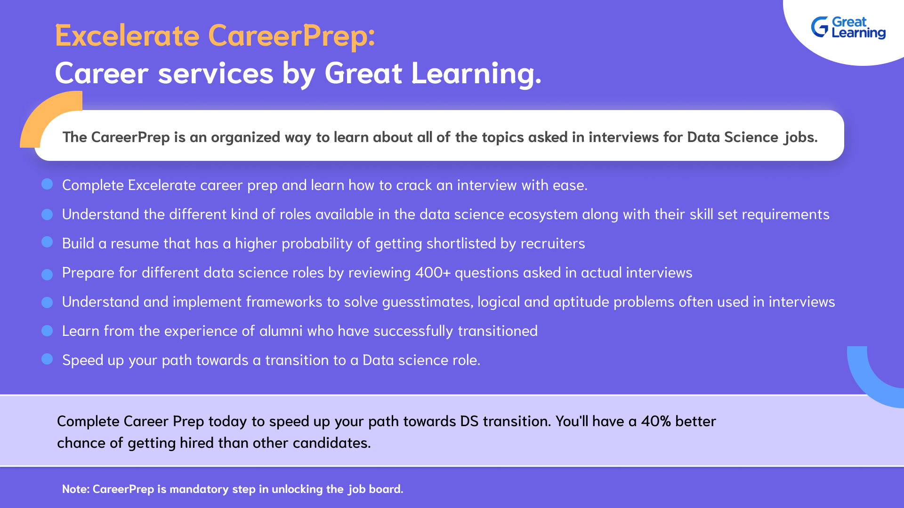

Slide 12

HAPPY LEARNING
Proprietary content. ©Great Learning. All Rights Reserved. Unauthorized use or distribution prohibited.

